Slide 1

Predicting best location for buying home
Applied Data Science Capstone
IBM Data Science Professional Certification
patelankit706@gmail.com

Slide 2
Problem Description
Most of us will reach internet and property advisor for buying homes.
Do they consider parameters such as number of
medical facilities,
entertainment zones,
shopping places,
outdoor & recreational places
near that area while suggesting you home?
The answer surely is no.
What if someone do this for you and consider above parameters?
This is exactly our project is all about

Slide 3
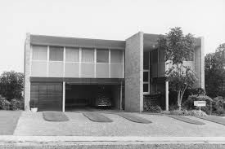
Problem Description
We are particularly interested in finding areas in New York city with good liveability index and pocket friendly property rates.
Liveability of place considers following parameters
Medical Facilities
Shopping & Services
Food and Restaurant
Arts & Entertainment Zones
Outdoor & Recreational activities

Slide 4
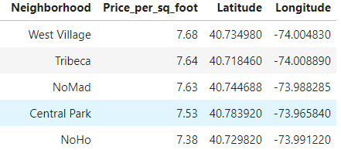
Data Needed
property price of each area in New York can be obtained by web scraping this page and their respective coordinates can be obtained using HERE Maps API geocoding

Slide 5
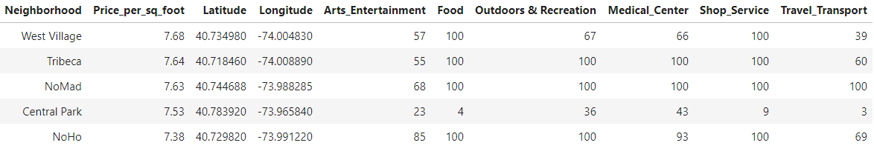
Data Needed
parameters such as number of Medical Centers, Shopping, Arts & Outdoor Recreational places in each area will be obtained using Foursquare API by using explore endpoint with category parameter

Slide 6
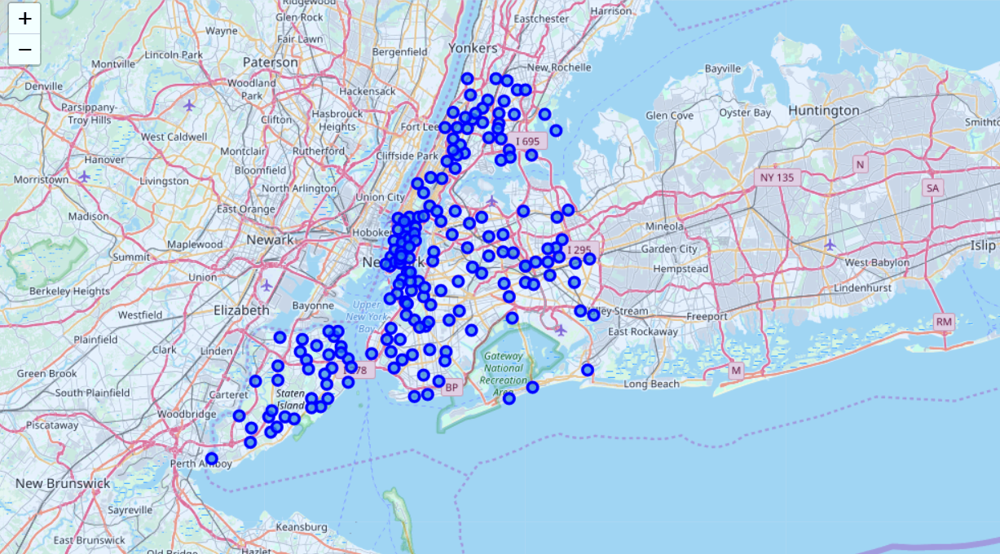
Methodology
Part 1:
Identifying neighborhood in New York City

Slide 7
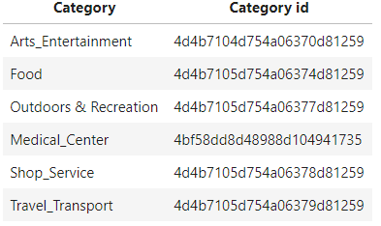
Methodology
Part 2:
Connecting to Foursquare and Retrieving Locational Data for Each Venue in Every Neighborhood
let's use Foursquare API to get info on different venues in each neighborhood. We are only interested in venue categories given below:
The Category id's of different categories are obtained from following web page: Foursquare Venues

Slide 8
Methodology
Part 3:
We have selected following features for clustering purpose:
Price_per_sq_foot
Arts_Entertainment
Food
Outdoors & Recreation
Medical_Center
Shop_Service
Travel_Transport
Scaling

Slide 9
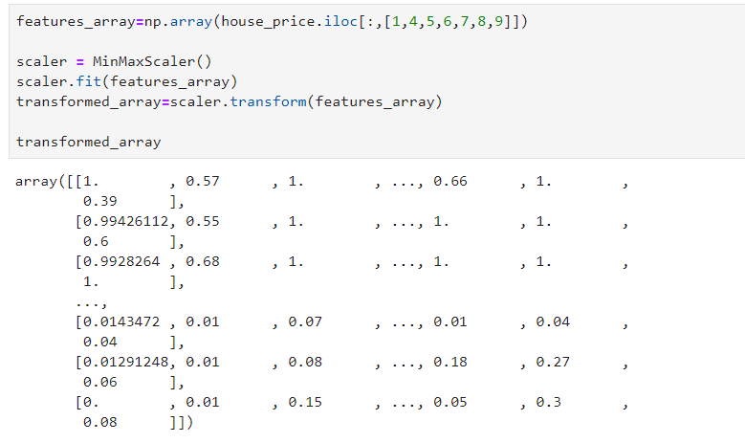
Methodology

Slide 10
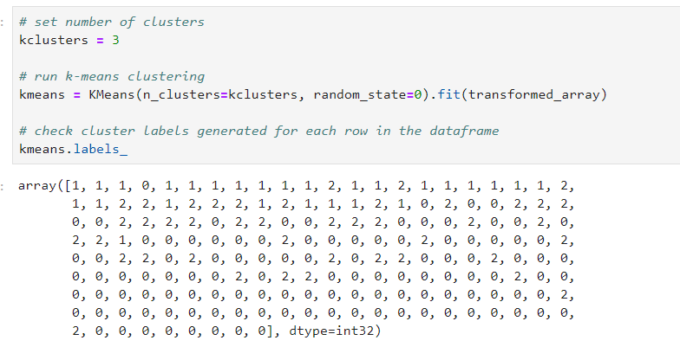
Methodology
Part 4:
Applying K Means Clustering

Slide 11
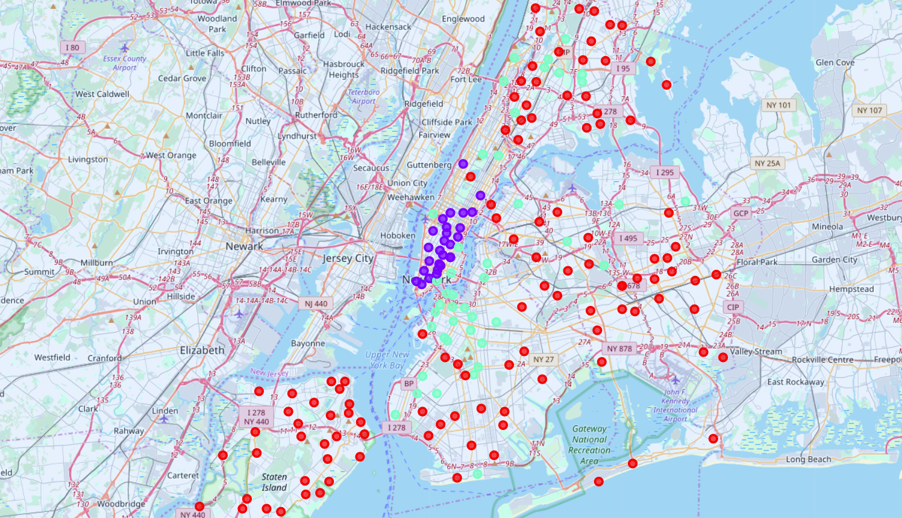
Methodology

Slide 12
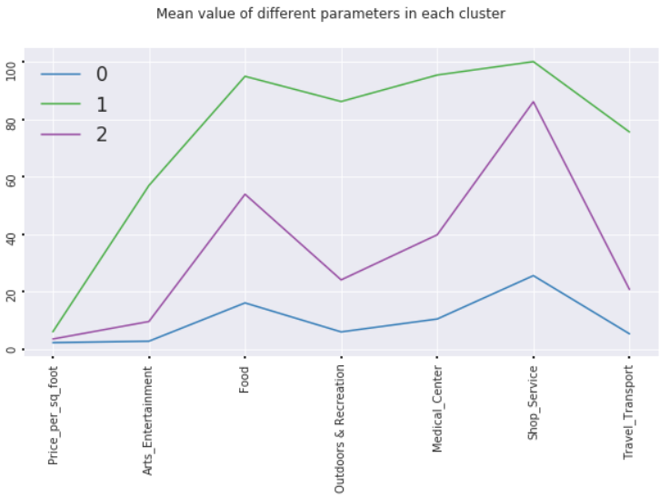
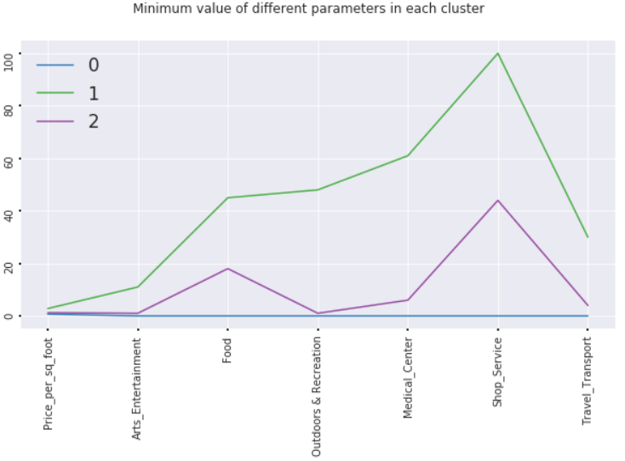
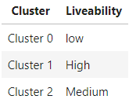
Results

Slide 13
Results
For Cluster 1 liveability is high i.e. number of restaurants, hospitals, travelling, shopping and entertainment options are great but the starting property price in this region is high.
For Cluster 2 liveability is medium i.e. compromise in either number of restaurants, hospitals, travelling, shopping and entertainment options or less property price, but budget friendly options might also be present in this cluster.
For Cluster 0 liveability is low i.e. number of restaurants, hospitals, travelling, shopping and entertainment options are less.

Slide 14
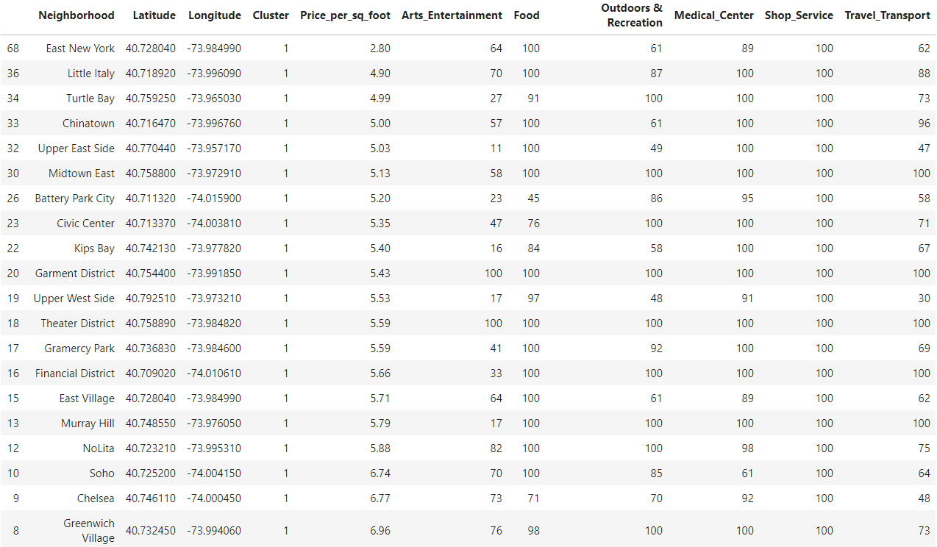
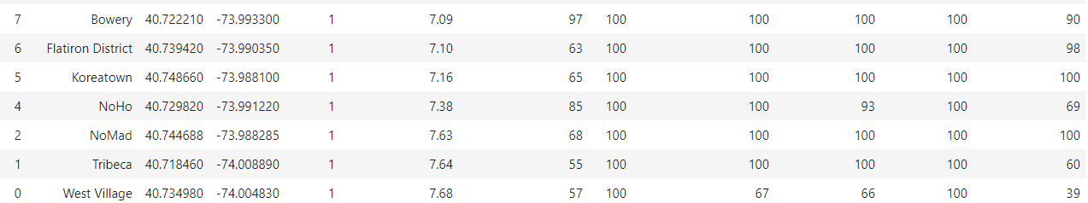
Results
Houses priced 2.80 $ or more

Slide 15
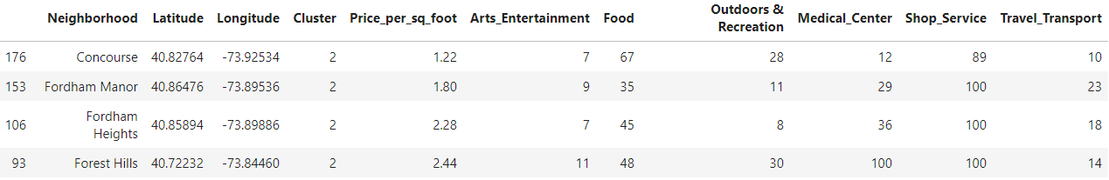
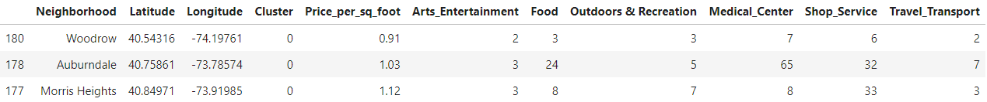
Results
Houses priced between 1.22$ to 2.80$
House priced less than 1.22$

Slide 16
Results
Cluster 1
If your budget is above 2.80 dollar, some of the best places to buy house in this cluster
East New York with lowest price of 2.80 dollar per sq foot
Little Italy with price of 4.90 dollar per sq foot
Turtle Bay with price of 4.99 dollar per sq foot and so, on
Cluster 2
If you budget ranges from 1.22 to 2.80 dollar the best places in this cluster with medium liveability are
Concourse with a price of 1.22
Fordham Manor with a price of 1.80
Fordham heights with a price of 2.28 and so on

Slide 17
Results
Cluster 0
The best places in this cluster with fair liveability if you budget is below 1.22 dollar are
Woodrow with a price of 0.91
Auburndale with a price of 1.03
Morris Heights with a price of 1.12

Slide 18

Thank You !!!

